Slide 1
Lord of the Flies
Please have your RAW Book out on your desk

Slide 2
Do Now: Conformity/
Peer Pressure
Webster’s Dictionary defines “conformity” as agreement in form, manner, or character. Copy this definition into your RAW Book.
Brainstorm a list of at least 5 ways you are pressured to conform. In addition to peer pressure, you may also want to consider family pressures and societal pressures.
What are the negative effects of peer pressure?
Can there be positive effects of peer pressure? Explain.

Slide 3
The Asch Study
Psychology of Conformity – Watch: Asch Study
Consider/Discuss these questions:
  Why do you think people conformed?
  When people didn’t conform, what were the circumstances?
  What are some possible conclusions about human nature that can be drawn from the reasons why people didn’t conform?

Slide 4
Lord of the Flies
Background Information

Slide 5
The Bombing of London
In September of 1940, Germany began bombing London. They later bombed other major cities.
To keep the children of London safe, the government began sending them to stay with people who lived in the country.

Slide 6
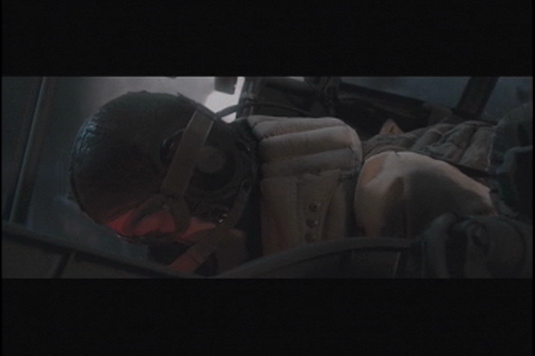
Movie Clip: “The Lion, The Witch, and The Wardrobe”
Narnia Clip

Slide 7
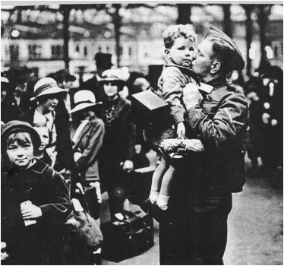
A soldier kisses his son goodbye
Notice the son’s identification tag.

Slide 8

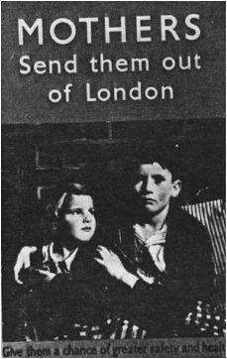
Propaganda Posters

Slide 9
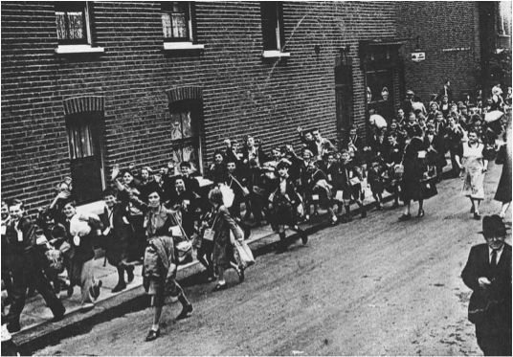
Evacuation of Northeast London, 1939

Slide 10
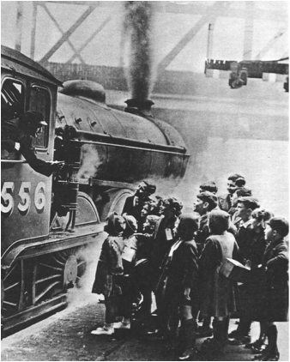
Children prepare to board a train to the country

Slide 11
In the words of Joan
“ Smut the cat, Joey the canary and a large tortoise we had had 16 years…what were we to do with them? There was only one thing left and that was to have them put to sleep. I bravely put Smut into a box, the tortoise in a bag on my back, the cage in the other hand. I walked along Hastings seafront to the vet’s. I can tell you how much I hated Hitler.”

Slide 12
In the words of Vera,
13 years old
“There never ought to be wars if we were governed properly. There’s always old people in power, and young people grow up…restless. I’ve been to so many different schools since the war’s been on that I can’t settle down, and then I’m blamed because I don’t work well. It’s a terrible thing, war; such a waste of life and energy, and my opinion is that the country will suffer for years and years.”

Slide 13
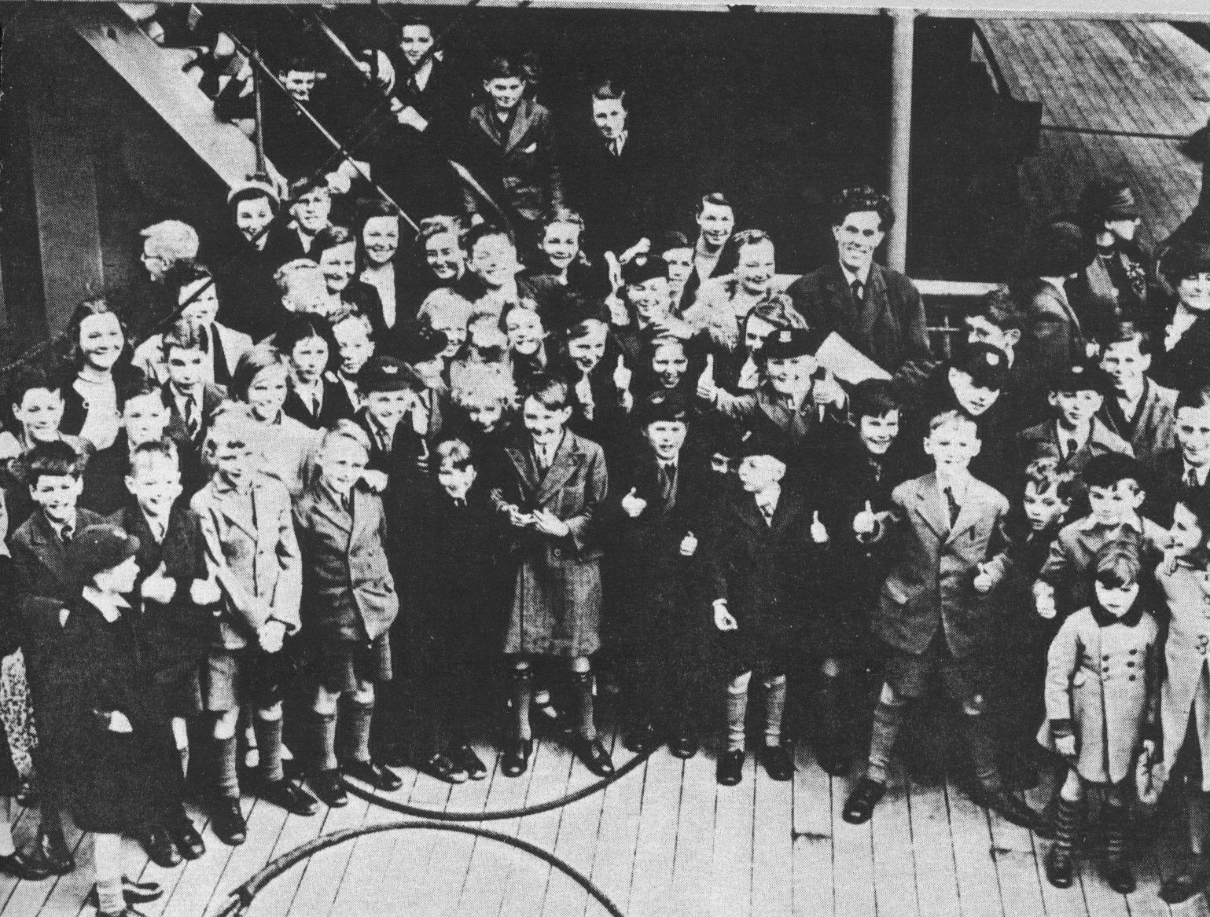
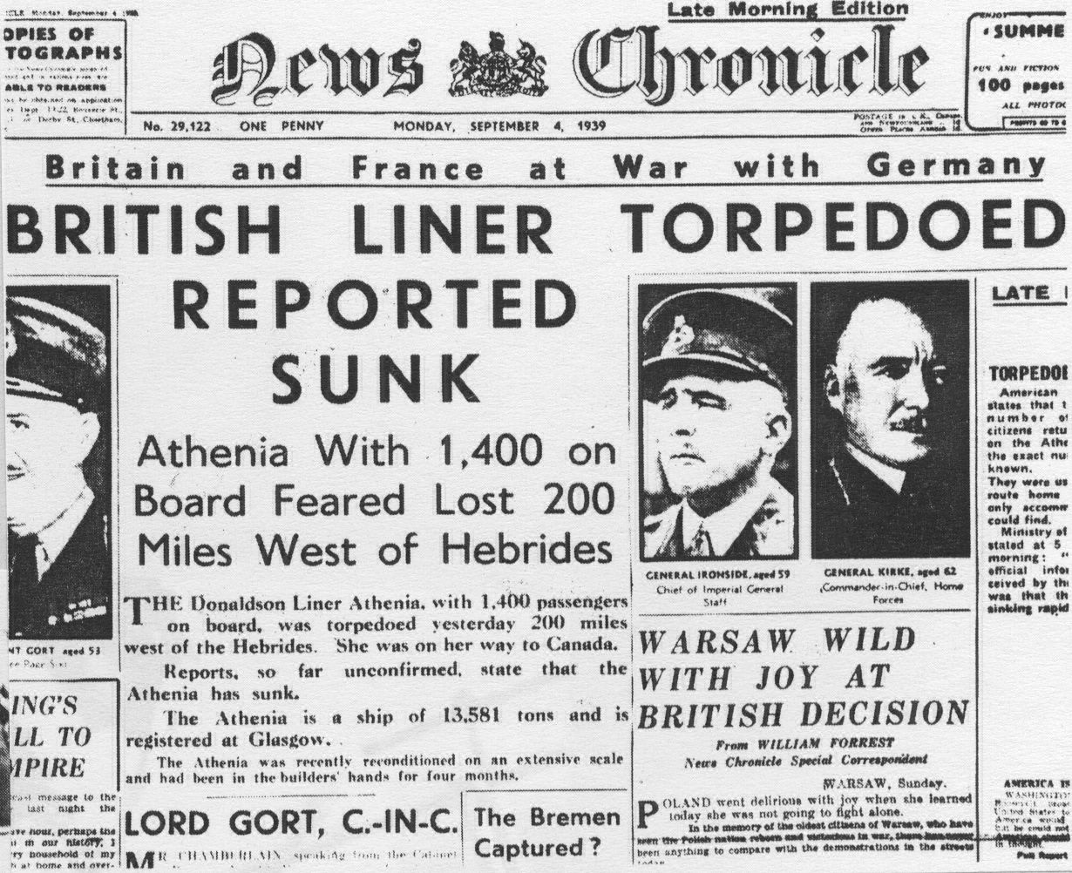
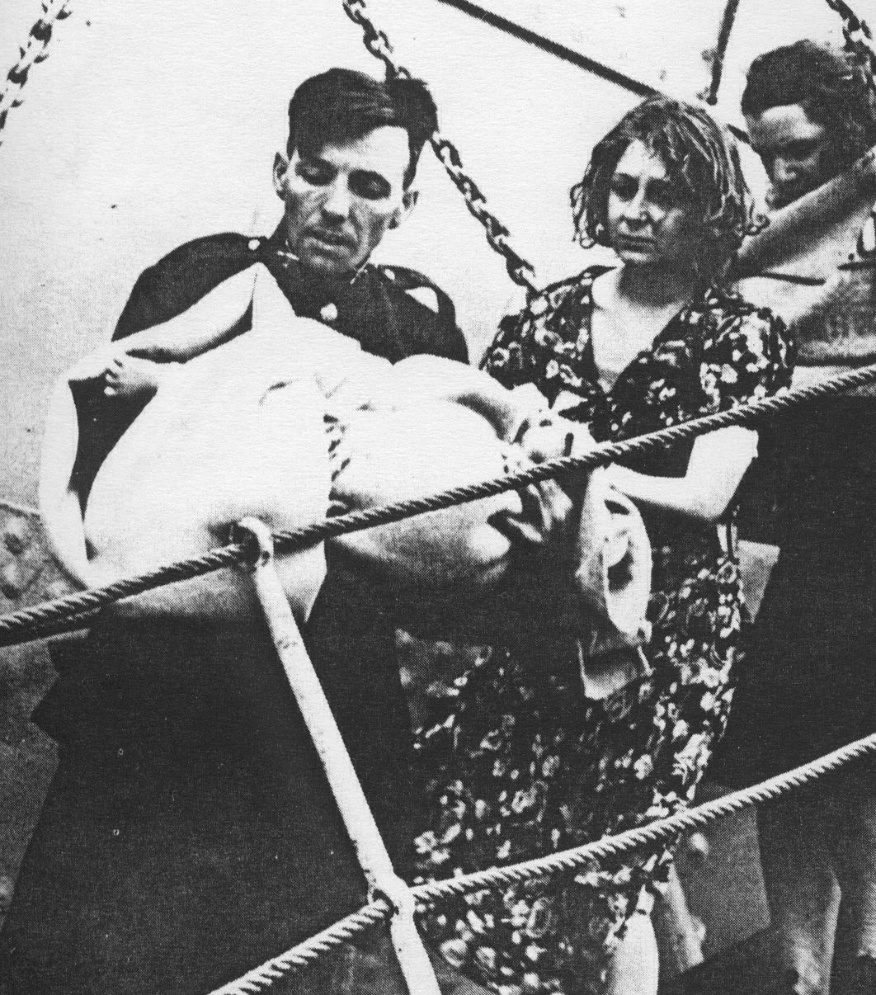
Preparing to sail…
Ship torpedoed.
Rescued passengers

Slide 14
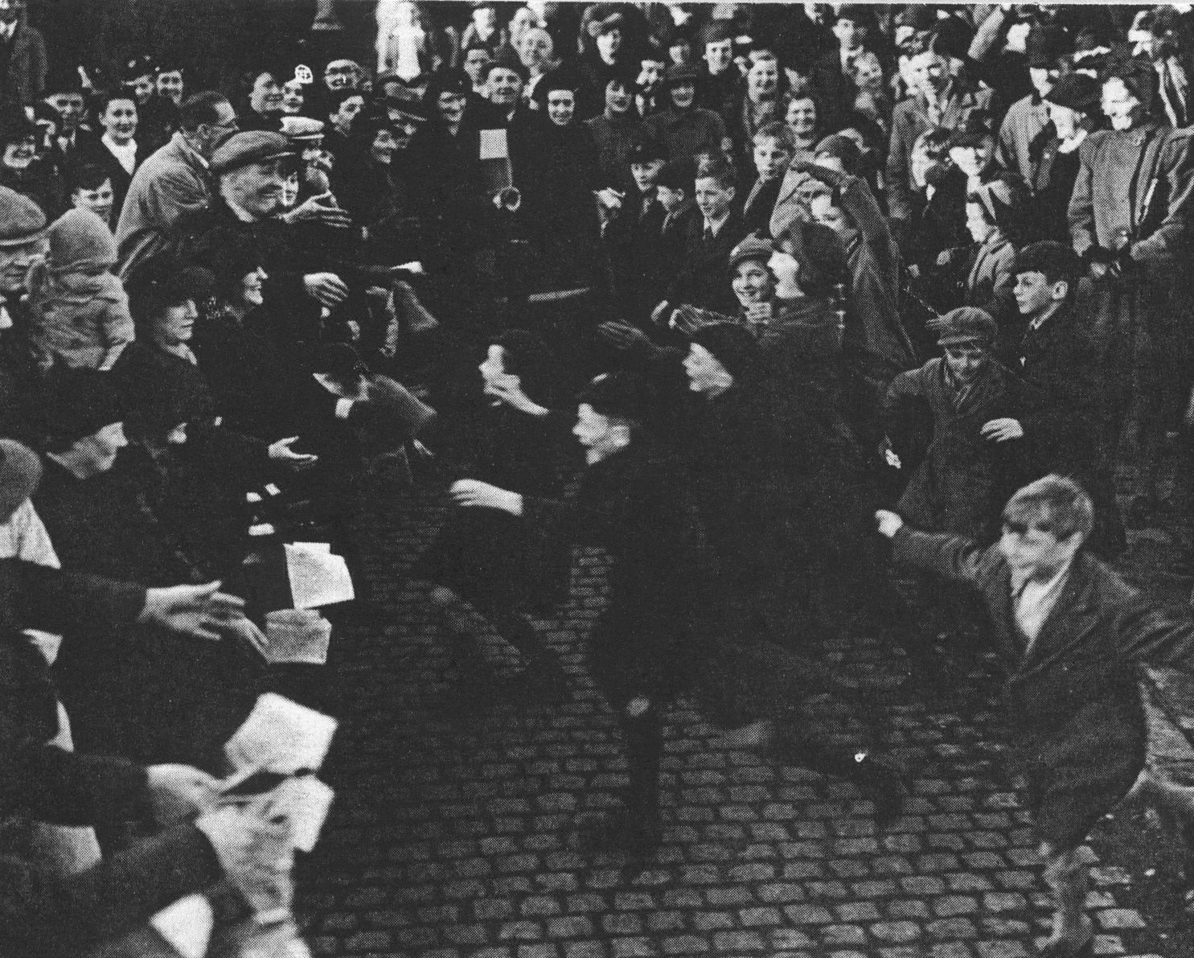
Homecoming…

